Slide 1
J2SE
Exception Handling

Slide 2
Program Defects and “Bugs”
A program may be efficient, but is worthless if it produces a wrong answer
Defects often appear in software after it is delivered
Testing can never demonstrate the complete absence of defects
In some situations it is very difficult to test a software product completely in the environment in which it is used
Debugging: removing defects

Slide 3
Types of Errors
Syntax Error
Runtime Error (or Exception)
Logic Error

Slide 4
Syntax Errors
Mistakes in grammar of the language
Detected by compiler
Prevent successful compilation
Examples:
Omitting or misplacing braces or semicolons
Performing an incorrect type of operation on a primitive type value
Invoking an instance method not defined
Not declaring a variable before using it
Providing multiple declarations of a variable

Slide 5
Run-time Errors or Exceptions
Run-time errors
Occur during program execution
Occur when the JVM detects an operation that it knows to be incorrect
Cause the JVM to throw an exception
Examples of run-time errors include
Integer division by zero
Array index out of bounds
Number format and Input mismatch error
Null pointer exceptions
** Refer to the ExceptionSample1.java sample code
** Refer to the ExceptionSample2.java sample code

Slide 6
What is an Exception?
In procedural programming, it is the responsibility of the programmer to ensure that the programs are error-free
Errors have to be checked and handled manually by using some error codes
But this kind of programming was very cumbersome and led to spaghetti code
Java provides an excellent mechanism for handling runtime errors
Notes:
Use of error codes in error handling entailed a structure of code in which error logic and application logic are mixed in owing to conditional checks for occurrence of certain errors.

Slide 7
What is an Exception?
An exception is an event that occurs during the execution of a program that disrupts the normal flow of instructions
The ability of a program to intercept run-time errors, take corrective measures and continue execution is referred to as exception handling

Slide 8
What is an Exception?
Consider an example in which we try to open a file and read from it:
ask the user to enter the name of a file
open the file
read the contents
close the file
There are various situations when an exception could occur:
Attempting to access a file that does not exist
Inserting an element into an array at a position that is not in its bounds
Performing some mathematical operation that is not permitted
Declaring an array using negative values
Using an un-initialized instance variable
Notes:
The code for this program compiles without any error. However, during execution, it could encounter an error if the file referred to in the program is not available. This causes the program to terminate abruptly. But this situation should not arise at run-time.

Slide 9
Handling Exceptions
Unchecked exceptions (including errors)
These are considered unrecoverable
Programmers not “expected” to handle them (but expected not to cause them)
Checked exceptions
Due to external conditions, often recoverable

Slide 10
Catching and Handling Exceptions
When an exception is thrown, the normal sequence of execution is interrupted
Default behavior
Program stops
JVM displays an error message and stack trace
The programmer may override the default behavior by
Enclosing statements in a try block
Processing the exception in a catch block

Slide 11
The try-catch-finally Sequence
Avoid uncaught exceptions
Write a try-catch sequence to catch an exception
Handle it rather than relying on the JVM
Catch block is skipped if all statements within the try block execute without error
Finally (if provided) is executed after try block or catch block
Use this to “clean up” (e.g. close open files)

Slide 12
Try-catch-finally
try {
//statements that might cause exception
}
catch (EOFException ex){
//code for EOF Exception
}
catch(IOException ex){
//code for IO Exception
}
finally{
//code executed after try or catch code
}

Slide 13
Handling Exceptions to Recover from Errors
Exceptions provide the opportunity to
Recover from errors (preferable, if possible)
Report errors
First matching Catch block (only) is executed
Match according to the type of exception
Compiler displays an error message if it encounters an unreachable catch clause
Example: IOException with no IO in try clause
** Refer to the Exception1.java sample code

Slide 14
Exception Types
Exceptions are implemented in Java through a number of classes
Throwable is at the top of the exception class hierarchy
It has two subclasses –
the Exception class
the Error class.
The Exception class has a subclass called RunTimeException.
Exceptions that belong to RunTimeException handle various situations such as division by zero, file not found etc.
Notes:
The Exception class is used for the exceptional conditions that may arise in a program, and that should be handled by it. It has a subclass – called RunTimeException. The Exception class is also used to create your own exceptions.
The other branch is topped by Error, which defines exceptions that are not expected to be caught under normal circumstances by your program. Exceptions of type Error are used by the Java runtime system to indicate errors having to do with the runtime environment itself. Stack overflow is an indication of such an error. Exceptions of type Error are beyond the control of your program.

Slide 15
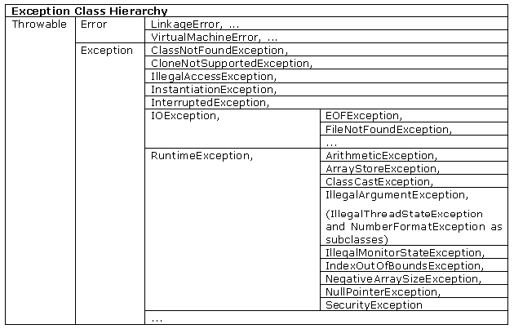
Exception Types
Notes:
The Exception class is used for the exceptional conditions that may arise in a program, and that should be handled by it. It has a subclass – called RunTimeException. The Exception class is also used to create your own exceptions.
The other branch is topped by Error, which defines exceptions that are not expected to be caught under normal circumstances by your program. Exceptions of type Error are used by the Java runtime system to indicate errors having to do with the runtime environment itself. Stack overflow is an indication of such an error. Exceptions of type Error are beyond the control of your program.

Slide 16
Uncaught Exceptions
class Demo {
public static void main(String args[]) {
int x = 0;
int y = 50/x;
System.out.println(“y = “ +y);
}
}
Although this program will compile, but when you execute it, the Java run time-system will generate an exception and displays the following output on the console
java.lang.ArithmeticException: / by zero at Demo.main(Demo.java:4)
Notes:
The following example declares two integers x and y. x is initialized to zero. Then the program divides 50 by x and stores this value in y. Finally it prints the value of y.
It means that the name of the exception is ArithmeticException, and the exception has occurred while dividing the number by zero. The classname, Demo; the method name, main; the filename, Demo.java; and the line number, 4, all are printed.

Slide 17
The Exception Class Hierarchy
When an exception is thrown, one of the Java exception classes is instantiated
Exceptions are defined within a class hierarchy that has the class Throwable as its superclass
Classes Error and Exception are subclasses of Throwable
RuntimeException is a subclass of Exception

Slide 18
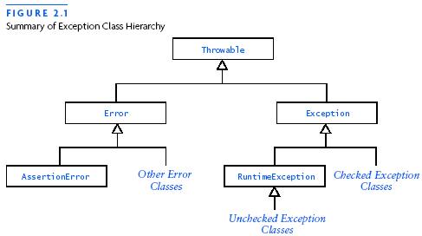
Throwable Exception Hierarchy

Slide 19
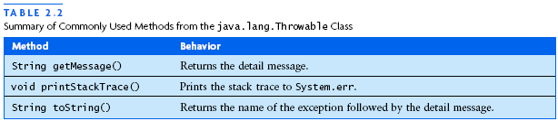
Methods of Throwable
(Inherited by subclasses)

Slide 20
Exception Types
There are several built-in exception classes that are used to handle the very fundamental errors that may occur in your programs.
You can create your own exceptions also by extending the Exception class.
These are called user-defined exceptions, and will be used in situations that are unique to your applications.

Slide 21
Handling Runtime Exceptions
Whenever an exception occurs in a program, an object representing that exception is created and thrown in the method in which the exception occurred
Either you can handle the exception, or ignore it
In the latter case, the exception is handled by the Java run-time-system and the program terminates
However, handling the exceptions will allow you to fix it, and prevent the program from terminating abnormally

Slide 22
Handling Runtime Exceptions
Java’s exception handling is managed using the following keywords: try, catch, throw, throws and finally.
try {
// code comes here
} catch(TypeofException obj) {
//handle the exception
} finally {
//code to be executed before the program ends
}

Slide 23
Handling Runtime Exceptions
Any part of the code that can generate an error should be put in the try block
Any error should be handled in the catch block defined by the catch clause
This block is also called the catch block, or the exception handler
The corrective action to handle the exception should be put in the catch block
Notes:
Once the catch statement has executed, program control continues with the next line in the program following the entire try/catch mechanism

Slide 24
Handling Runtime Exceptions
class ExceptDemo {
public static void main(String args[]){
int x, a;
try {
x = 0;
a = 22 / x;
System.out.println("This will be bypassed.");
} catch (ArithmeticException e){
System.out.println("Division by zero.");
}
System.out.println("After catch statement.");
}
}
Notes:
Notice that the call to println( ) inside the try block is never executed. Once an exception is thrown, program control transfers out of the try block into the catch block. catch block is executed. Execution never returns to the try block from a catch. Thus the line “This will be bypassed” is not displayed. Once the catch statement has executed, program control continues with the next line in the program following the entire try/catch mechanism.
Throwable overrides the toString( ) defined by Object so that it returns a string containing a description of the exception. You can display this description in a println( ) statement by simply passing the exception object as an argument.
catch (ArithmeticException e) { // catch divide-by-zero error
System.out.println("Division by zero.");
System.out.println(“Exception :” + e);
}

Slide 25
Multiple Catch Statements
A single block of code can raise more than one exception
You can specify two or more catch clauses, each catching a different type of execution
When an exception is thrown, each catch statement is inspected in order, and the first one whose type matches that of the exception is executed
After one catch statement executes, the others are bypassed, and execution continues after the try/catch block.
** Refer to the Exception2.java sample code

Slide 26
Multiple Catch Statements
class MultiCatch {
public static void main(String args[]){
try {
int l = args.length;
System.out.println("l = " + l );
int b = 42 / l;
int arr[] = { 1 };
arr[22] = 99;
} catch(ArithmeticException e){
System.out.println("Divide by 0: " + e);
} catch(ArrayIndexOutOfBoundsException e){
System.out.println("Array index oob: " + e);
}
System.out.println("After try/catch blocks.");
}
}

Slide 27
Multiple Catch Statements Involving Exception Superclasses and Subclasses
When you use multiple catch statements, it is important to remember that exception subclasses must come before any of their exception superclasses
This is because a catch statement that uses a superclass will catch exceptions of that type as well as exceptions of its subclasses
Thus, a subclass exception would never be reached if it came after its superclass that manifests as an unreachable code error
** Refer to the Exception3.java sample code
Notes:
/* This program contains an error. A subclass must come before its superclass in a series of catch statements. If not, unreachable code will be created and a compile-time error will result. */
class SuperSubCatch {
public static void main(String args[]) {
try {
int a = 0;
int b = 42 / a;
} catch(Exception e) {
System.out.println("Generic Exception catch.");
}
/* This catch is never reached because ArithmeticException is a subclass of Exception.*/
catch(ArithmeticException e) { // ERROR - unreachable
System.out.println("This is never reached.");
}
}
}

Slide 28
Nested try Statements
The try statement can be nested
Each time a try statement is encountered, the context of that exception is pushed on the stack
If an inner try statement does not have a catch handler for a particular exception, the outer block’s catch handler will handle the exception
This continues until one of the catch statement succeeds, or until all of the nested try statements are exhausted
** Refer to the Exception7.java sample code
Notes:
If no catch statement matches, then the Java runtime system will handle the exception.
class NestedTryDemo {
public static void main(String args[]) {
try {
try {
FileInputStream fis = new FileInputStream(args[0];
}
catch(IOException e)
{System.out.println(“read error”);}
catch(FileNotFoundException e)
{System.out.println(“File Does Not Exist”);}
}}

Slide 29
Using throw
System-generated exceptions are thrown automatically
At times you may want to throw the exceptions explicitly which can be done using the throw keyword
The exception-handler is also in the same block
The general form of throw is:
throw ThrowableInstance
Here, ThrowableInstance must be an object of type Throwable, or a subclass of Throwable
Notes:
Simple types, such as int or char, as well as non-Throwable classes, such as String or Object, cannot be used as exceptions. There are two ways you can obtain a Throwable object: using a parameter into the catch clause, or creating one with the new operator.
The flow of execution stops immediately after the throw statement; any subsequent statements are not executed. The nearest enclosing try block is inspected to see if it has a catch statement that matches the type of the exception. If it does find a match, control is transferred to that statement. If not, the next enclosing try statement is inspected, and so on. If no matching catch is found, then the default exception handler halts the program and prints the stack trace.

Slide 30
Using throw
class ThrowEg {
static void demofunc(){
try {
throw new ArithmeticException( );
} catch(ArithmeticException e){
System.out.println("Caught inside demoproc.");
throw e;
}
}
public static void main(String args[]){
try {
demofunc();
} catch(ArithmeticException e){
System.out.println("Recaught: " + e);
}
}
}
Notes:
This program gets two opportunities to deal with the same error. First, main( ) sets up an exception context and then calls demoproc( ). The function demoproc( ) sets up another exception-handling context, and throws a new instance of ArithmeticException, which is caught on the next line. The exception is re-thrown. Here, new is used to construct an instance of ArithmeticException. All of Java’s built-in runtime exceptions have at least two constructors, one with no parameters, and one that takes a String as a parameter. When the second form is used, the argument specifies a string that describes the exception. This string is displayed when the exception object is used as an argument to print( ) or println( ). It can also be obtained by a call to getMessage( ), which is defined by Throwable.

Slide 31
Using throws
Sometimes, a method is capable of causing an exception that it does not handle
Then, it must specify this behaviour so that callers of the method can guard themselves against that exception
While declaring such methods, you have to specify what type of exception it may throw by using the throws keyword
A throws clause specifies a comma-separated list of exception types that a method might throw:
type method-name( parameter list) throws exception-list
** Refer to the Exception8.java sample code
** Refer to the Exception9.java sample code
Notes:
This is necessary for all exceptions, except those of type Error or RuntimeException, or any of their subclasses. All other exceptions that a method can throw must be declared in the throws clause.
Later, wherever this method is called, the exception handler should be provided by way of the try and catch block.

Slide 32
Using throws
class ThrowsDemo {
static void throwOne(){
System.out.println("Inside throwOne.");
throw new FileNotFoundException();
}
public static void main(String args[]){
throwOne();
}
}

Slide 33
Using throws
import java.io.*;
class ThrowsDemo {
static void throwOne() throws FileNotFoundException{
System.out.println("Inside throwOne.");
throw new FileNotFoundException();
}
public static void main(String args[]) {
try {
throwOne();
} catch (FileNotFoundException e){
System.out.println("Caught " + e);
}
}
}

Slide 34
Using finally
When an exception occurs, the execution of the program takes a non-linear path, and could bypass certain statements
A program establishes a connection with a database, and an exception occurs
The program terminates, but the connection is still open
To close the connection, finally block should be used
The finally block is guaranteed to execute in all circumstances
** Refer to the Exception4.java sample code
** Refer to the Exception5.java sample code
** Refer to the Exception6.java sample code
Notes:
Even if the exception is caused, the control will go to the finally block before going to the exception handler. If an exception is thrown, the finally block will execute even if no catch statement matches the exception. Any time a method is about to return to the caller from inside a try/catch block via an uncaught exception, or an explicit return statement, the finally clause is also executed just before the method returns. The finally block is optional, but usually the cleanup code like closing the files is kept in the finally block.
The finally clause is optional. However, each try statement requires at least one catch or a finally clause.

Slide 35
Using finally
** Refer to the FinallyDemo.java sample code
Notes:
Here, funcA( ) prematurely breaks out of the try block by throwing an exception. The finally clause is executed on the way out.

Slide 36
Trace a Program Execution
Suppose no exceptions in the statements
try {
statements;
}
catch(TheException ex) {
handling ex;
}
finally {
finalStatements;
}
Next statement;

Slide 37
Trace a Program Execution
The final block is always executed
try {
statements;
}
catch(TheException ex) {
handling ex;
}
finally {
finalStatements;
}
Next statement;

Slide 38
Trace a Program Execution
Next statement in the method is executed
try {
statements;
}
catch(TheException ex) {
handling ex;
}
finally {
finalStatements;
}
Next statement;

Slide 39
Trace a Program Execution
Suppose an exception of type Exception1 is thrown in statement2
try {
statement1;
statement2;
statement3;
}
catch(Exception1 ex) {
handling ex;
}
finally {
finalStatements;
}
Next statement;

Slide 40
Trace a Program Execution
The exception is handled.
try {
statement1;
statement2;
statement3;
}
catch(Exception1 ex) {
handling ex;
}
finally {
finalStatements;
}
Next statement;

Slide 41
Trace a Program Execution
The final block is always executed.
try {
statement1;
statement2;
statement3;
}
catch(Exception1 ex) {
handling ex;
}
finally {
finalStatements;
}
Next statement;

Slide 42
Trace a Program Execution
The next statement in the method is now executed.
try {
statement1;
statement2;
statement3;
}
catch(Exception1 ex) {
handling ex;
}
finally {
finalStatements;
}
Next statement;

Slide 43
Trace a Program Execution
statement2 throws an exception of type Exception2.
try {
statement1;
statement2;
statement3;
}
catch(Exception1 ex) {
handling ex;
}
catch(Exception2 ex) {
handling ex;
throw ex;
}
finally {
finalStatements;
}
Next statement;

Slide 44
Trace a Program Execution
try {
statement1;
statement2;
statement3;
}
catch(Exception1 ex) {
handling ex;
}
catch(Exception2 ex) {
handling ex;
throw ex;
}
finally {
finalStatements;
}
Next statement;
Handling exception

Slide 45
Trace a Program Execution
try {
statement1;
statement2;
statement3;
}
catch(Exception1 ex) {
handling ex;
}
catch(Exception2 ex) {
handling ex;
throw ex;
}
finally {
finalStatements;
}
Next statement;
Execute the final block

Slide 46
Trace a Program Execution
try {
statement1;
statement2;
statement3;
}
catch(Exception1 ex) {
handling ex;
}
catch(Exception2 ex) {
handling ex;
throw ex;
}
finally {
finalStatements;
}
Next statement;
Rethrow the exception and control is transferred to the caller

Slide 47
Checked and Unchecked Exceptions
Checked Exception
Beyond control of programmer
Direct subclasses of java.lang.Exception represent exceptions that the developer must deal with (but not RuntimeException)
These exceptions can only be thrown if declared in the throws clause of the method
Any code calling a method that throws a regular exception must catch it and deal with it
Unchecked Exception may result from
Programmer error
Serious external conditions that are unrecoverable
Subclasses of RuntimeException
Unchecked exceptions need not be declared in the throws clause of a method and do not need to be caught
These are exceptions that are too frequent to check for every time
Unchecked exceptions are derived from java.lang.RuntimeException instead of java.lang.Exception
RuntimeException is derived from Exception though

Slide 48
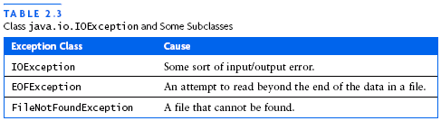
Example: Checked Exceptions
Some examples of checked exceptions are:
java.lang.ClassNotFoundException - thrown by Class.forName()
java.io.IOException - thrown by many I/O operations
java.lang.IllegalAccessException - thrown by Class.newInstance()
java.lang.InterruptedException - thrown by sleep and wait

Slide 49
Example: Unchecked Exceptions
Some example of unchecked exceptions:
java.lang.ArithmeticException
java.lang.ClassCastException
java.lang.IllegalArgumentException
java.lang.NumberFormatException
java.lang.ArrayIndexOutOfBoundsException
java.lang.StringIndexOutOfBoundsException
java.lang.NegativeArraySizeException
java.lang.NullPointerException

Slide 50
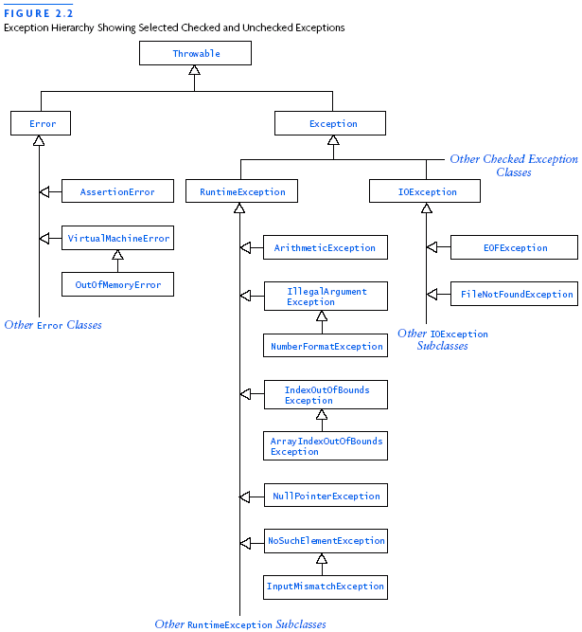
Exception Hierarchy

Slide 51
Guidelines for Exceptions
If an exception is recoverable in the current method, handle the exception in the current method
If a checked exception is likely to be caught in a higher-level method, declare that it can occur using a throws clause
It is not necessary to use a throws clause with unchecked exceptions

Slide 52
Assertions

Slide 53
About the assert statement
The purpose of the assert statement is to give you a way to catch program errors early
The assert statement is new in Java 1.4
The assert statement uses a new keyword, assert
The new keyword may break older programs that use assert as a user-defined name
Hence, there is a way to use the old syntax
With the old syntax, assert statements are syntax errors
There is also a way to “turn off” assert statements
When they are turned off, Java just ignores assert statements
Unfortunately, this also means that your assert statements may be off when you think they are working and doing their job

Slide 54
Syntax
There are two forms of the assert statement:
assert booleanExpression;
This statement tests the boolean expression
It does nothing if the boolean expression evaluates to true
If the boolean expression evaluates to false, this statement throws an AssertionError
assert booleanExpression : expression;
This form acts just like the first form
In addition, if the boolean expression evaluates to false, the second expression is used as a detail message for the AssertionError
The second expression may be of any type except void

Slide 55
Notes on writing assertions
An AssertionError is an Error, not an Exception
You do not need to put it in a try statement
You do not need to catch the error
Using an assert statement does not entail any extra work on your part
The second expression is seldom necessary
If an AssertionError is thrown, Java automatically gives you a stack trace, complete with the line number
Use the second expression only if you have useful information to add to the error message

Slide 56
Declaring Assertions
An assertion is declared using the new Java keyword assert in JDK 1.4 as follows:
assert assertion; or
assert assertion : detailMessage;
where assertion is a Boolean expression and detailMessage is a primitive-type or an Object value.

Slide 57
Executing Assertions
When an assertion statement is executed, Java evaluates the assertion. If it is false, an AssertionError will be thrown. The AssertionError class has a no-arg constructor and seven overloaded single-argument constructors of type int, long, float, double, boolean, char, and Object.
For the first assert statement with no detail message, the no-arg constructor of AssertionError is used. For the second assert statement with a detail message, an appropriate AssertionError constructor is used to match the data type of the message. Since AssertionError is a subclass of Error, when an assertion becomes false, the program displays a message on the console and exits.

Slide 58
Executing Assertions Example
public class AssertionDemo {
public static void main(String[] args) {
int i; int sum = 0;
for (i = 0; i < 10; i++) {
sum += i;
}
assert i == 10;
assert sum > 10 && sum < 5 * 10 : "sum is " + sum;
}
}

Slide 59
Compiling Programs with Assertions
Since assert is a new Java keyword introduced in JDK 1.4, you have to compile the program using a JDK 1.4 compiler. Furthermore, you need to include the switch –source 1.4 in the compiler command as follows:
javac –source 1.4 AssertionDemo.java
NOTE: If you use JDK 1.5, there is no need to use the –source 1.4 option in the command.

Slide 60
Running Programs with Assertions
By default, the assertions are disabled at runtime. To enable it, use the switch –enableassertions, or –ea for short, as follows:
java –ea AssertionDemo
Assertions can be selectively enabled or disabled at class level or package level. The disable switch is –disableassertions or –da for short. For example, the following command enables assertions in package package1 and disables assertions in class Class1.
java –ea:package1 –da:Class1 AssertionDemo

Slide 61
Assertions vs. Exceptions
When do you use assertions instead of exceptions?
Both catch problems in your program, but...
The intended usage is very different!
An exception tells the user of your program that something went wrong
An assertion documents something about your program
When an assertion fails, it tells you that you have a bug
You create Exceptions to deal with problems that you know might occur
You write assertions to state things you know (or think you know) about your program

Slide 62
When to throw Exceptions
Use Exceptions when you:
Test whether the parameters to a public method or public constructor are legal
If it’s public, then other people besides you, the author of this class, can call it
Do any input/output
You, the class author, cannot ensure the files will be there or be correct if they are there
In short,
Think of yourself as the author of this class only
Anything that could go wrong, that you have no control over within this class, deserves an Exception

Slide 63
When to use assertions
Frequently!
Assertions are intended to be cheap to write
Just drop them into your code any time you think of them
Example: assert age >= 0;
How hard is that?
Assertions are not intended as a debugging device (though they can be used that way)
Rather, assertions should be used to specify things that you believe to be true at various points in your program
Assertions provide documentation, not just error checking
Assertions are documentation that can be checked by the running program!

Slide 64
When not to use assertions
Do not use assertions to do necessary work
Assertions can be disabled (“turned off”)
It’s a really bad idea to have your program work correctly only when assertions are turned on!
Do not use assertions to check the arguments to public methods
Argument checking is part of the contract, and should work with or without assertions
There are more appropriate Exceptions to throw: IllegalArgumentException, NullPointerException, and IndexOutOfBoundsException are the main ones

Slide 65
Assertions can be disallowed
Earlier versions of Java did not have assertions
It’s possible that someone used assert as a variable or method name
We still want to be able to use older programs
This means we need to be able to disallow assert as a keyword
There is no problem with pre-existing binaries (.class files) that used assert as a user-defined name
The problem can arise when you recompile old source code
By default, javac uses the old syntax (no assert statements), but this will probably change with 1.5
To use assert statements, set a flag in your IDE, or add the flag -source 1.4 to your javac command line
Note that the compiler javac has changed, not the interpreter java

Slide 66
Assertions can be disabled
Disallowing assertions means they are not legal syntax; disabling assertions means they are legal but are turned off
By default, assertions are both disallowed and disabled
To enable assertions, use the -enableassertions (or -ea) flag on the java command line
You can also enable or disable assertions for a given package or class, but we won’t go into that here

Slide 67
Ensuring assertions are enabled
You don’t need to explicitly check whether assertions are allowed by the compiler
You’ll get a syntax error for your assert statement if they are not allowed
The following code, placed at the top of a class, will check whether assertions are enabled:
static { boolean assertsEnabled = false; assert assertsEnabled = true; // Intentional side effect!!! if (!assertsEnabled) throw new RuntimeException("Asserts must be enabled!!!"); }

